Slide 1
ITM7000 Master project
Dr. Qizhen Gu (Kimi)

Slide 2
RESEARCH PAPER
Chapter 1: introduction
Chapter 2 : Literature review
Chapter 3 Research framework
Chapter 4 Research methodology
Chapter 5 Research result
Chapter 6 Discussion and recommendation

Slide 3
Chapter 1: introduction
1.1 Background of Study - Broad Context and Introduction
Begin by introducing the broader field or subject area clearly
Provide general background information that sets the stage and gives readers a solid foundation.
Clearly state current trends, statistics, or practices that underscore the relevance of your research topic.
Clearly define and justify your chosen research context (e.g., country, industry, demographic group)

Slide 4
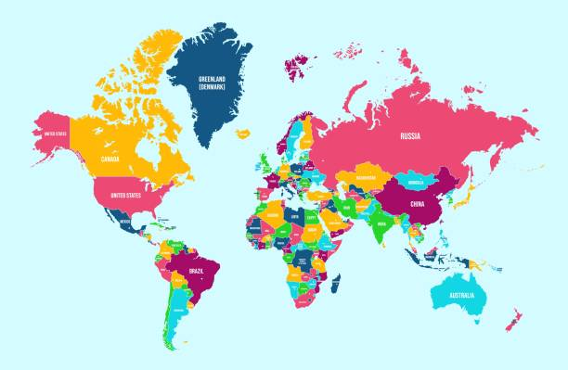
Chapter 1: introduction
Normally, this part talks about current market share situations based on 3 levels: International, Asia, and local country using data and figures

Slide 5
Chapter 1: introduction
1.2 Statement of problem
Clearly and briefly state the broader problem
Highlight the specific gap or deficiency in current knowledge
Explain clearly why the current state of research is incomplete.
The current problem of the company or product or service is facing.
Why your specific research topic is needed

Slide 6
Chapter 1: introduction
1.3 Research Objectives
Specific and Clear: Clearly state what you aim to examine.
Measurable: Can be answered through quantitative data.
Reflects Relationship or Impact: Typically involves examining relationships or causal effects between variables.
Ex. What is the impact of
1.4 Research Questions
SMART : Specific; Measurable; Achievable; Relevant; Time-bound.
Ex. To examine the impact of
Ex. To determine the mediating effect

Slide 7
Chapter 1: introduction
1.5 Scope of Research
Geographic Location: Country, city, region, or market of focus.
Population: Specify clearly your study’s target respondents
Variables of Interest: Clearly list the independent, dependent, and mediating variables.
Methodology: Indicate briefly the research method (quantitative survey descriptive; reliability; MLR)

Slide 8
Chapter 1: introduction
1.6 Research Limitations
Methodological Limitations - related to chosen research design, data collection techniques, or analysis methods.
Sampling Limitations - regarding sampling techniques, sample size, representativeness, or generalizability.
Measurement Limitations - due to survey/questionnaire biases, self-reporting issues
Geographical Limitations

Slide 9
Chapter 1: introduction
1.7 Significance of the Study
Theoretical Significance
Explain how your research fills gaps in existing literature or extends theory
Describe clearly how your study advances or enriches theoretical knowledge
Practical Significance
Describe clearly how your study benefits stakeholders such as businesses, consumers, marketers, or policymakers.
Highlight clearly the real-world implications of your findings.

Slide 10
Chapter 1: introduction
Definition of terms
Alphabetically List Each Term
Provides clear, operational definitions of the specific terms or concepts used within your study.
Each Term: provide one, most suitable definition.

Slide 11
Sampling Methods
Probability & Non-Probability sampling

Slide 12
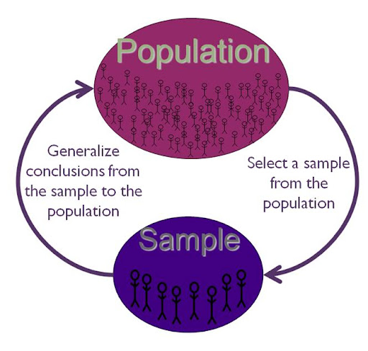

Slide 13
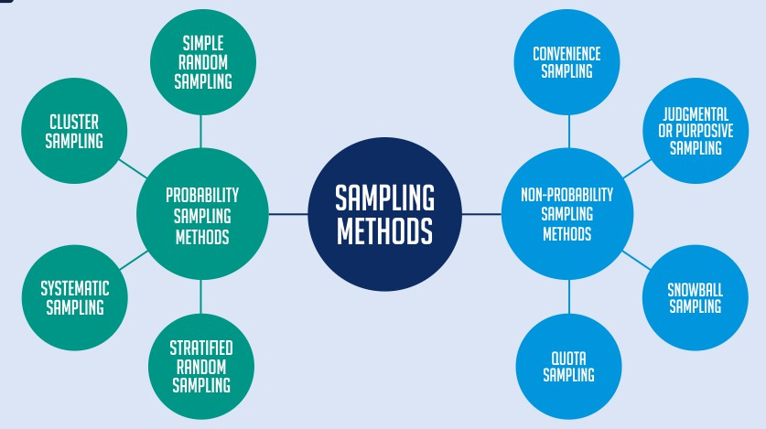
Sampling Methods
https://www.questionpro.com/blog/types-of-sampling-methods/

Slide 14
Non-Probability sampling
Sampling technique in which not all individuals in the target population have an equal chance of being selected as participants.
Easier access to participants and is often less costly and time-consuming, it may introduce sampling bias and limit the generalizability of findings.
Sampling | Definition
Convenience Sampling | Who are readily available to the researcher
Purposive (Judgmental) Sampling | Specific characteristics or purpose relevant to the study
Snowball Sampling | Existing participants recuit future participants
Quota Sampling | Pre-specified quotas for subgroups within the population.

Slide 15
Probability sampling
Every member of the target population has a known, non-zero chance of being selected as part of the study sample.
Gold standard in quantitative research because it reduces selection bias and enhances the validity and reliability.
Sampling | Definition
Simple Random Sampling | Every member of the population has equal chance of being selected (lucky draw)
Systematic Sampling | Every member of the population is selected from a list
Stratified Sampling | Divided into subgroups based on specific characteristics, using random samples for each subgroup.
Cluster Sampling | population is divided into clusters (often geographically)

Slide 16
Thank you
Faculty member of ITM
guqizhen@au.edu

Slide 17
Guest speaker Prof.Dr.lars
Wed,4 June 2025
AI BASED TECHNOLOGY AND SMART MARKETING
A72 HUAMAK CAMPUS, 10:00-11:45

